Slide 1
Producing 3D point cloud and digital elevation models through the use of unmanned aerial vehicles, Historic St. Luke’s Church case study
Team Members: Tangee Beverly, Cornelius Holness, Nigel Pugh, Tori Wilbon
Mentor: Mr. Clay Swindell

Slide 2
Abstract
This research project was initiated to demonstrate the ability of Unmanned Aerial Vehicles (UAV) to gather elevation and 3D data using only a visible light camera. The chosen test case was the structure and property associated with Historic St. Luke’s Church. This historic property represents Virginia’s oldest standing church built in the late 17th century. While the property area associated with the church covers several acres, The UAV team chose to focus on the historic structure and immediate surrounding area. The intention was to fly a DJI Phantom 2 Vision+ UAV along a gridded flight plan designed to capture an array of images at defined intervals. These images were subsequently processed with the Pix4d software to produce an image mosaic of the gridded area, a 3d point cloud and digital elevation model (DEM), and finally a 3D model of the historic structure. The dataset will expand on the historical and the geographic placement of the structure and will assist Historic St. Luke's in directing future archaeological and landscape studies on the property.
Keywords—archaeology, aerial imagery, DJI Phantom 2 Vision+, drone, Pix4D, remote sensing, U.A.V.

Slide 3
Objective
To produce aerial imagery which structural and elevation models could be generated
To make the data available to the church, so it could be used in future archaeological and landscape studies

Slide 4
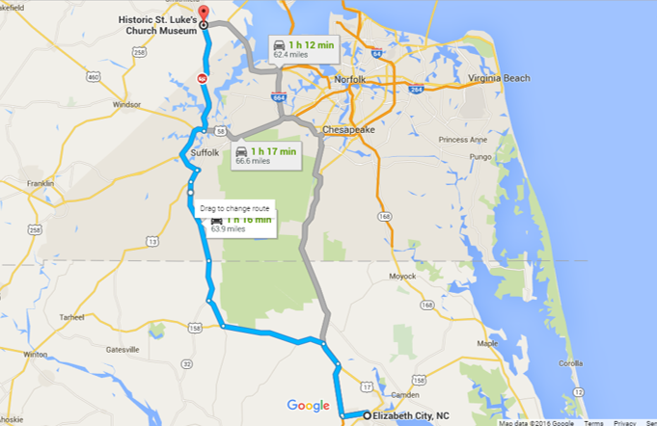
Area of Interest St. Luke’s Church

Slide 5
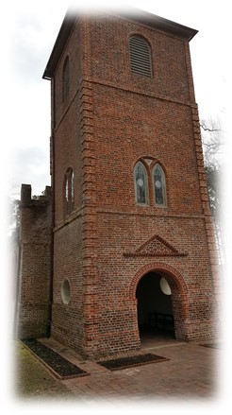
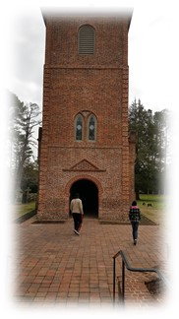
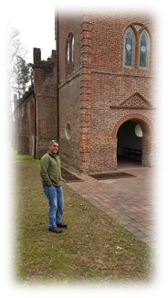
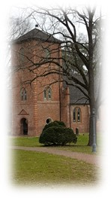
Area of Interest St. Luke’s Church
Located at Smithfield, Virginia
Built in early 1680’s
The oldest surviving ecclesiastical buildings in the state of Virginia
Previous name was The Newport Parish Church “Old Brick Church”
1960 was designated a National Historic Landmark
1966 was listed in the National Register of Historic places
1969 was listed in the Virginia Landmarks Register
Today offers tours of the historical landmark

Slide 6
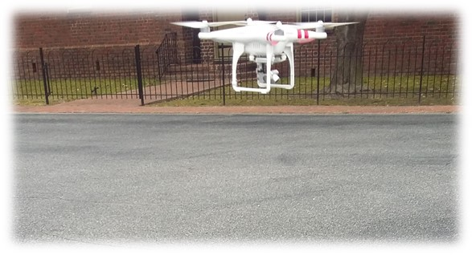
Equipment DJI Phantom 2 Vison
Inexpensive and versatile
Can operate autonomously or with minimal pilot training
Flight time is about 25 minutes
A built-in Naza-M V2 Flight Control System, with a gimbal and camera
Video captures
1080 pixels/30 frames per second
720 pixels/60 frames per second

Slide 7
Equipment Pix4D
Able to stitch images to create large mosaic photo
Build 3D point cloud from 2D imagery
Used Pix4D Mapper (free trial version)
Mobile application to plan flights

Slide 8
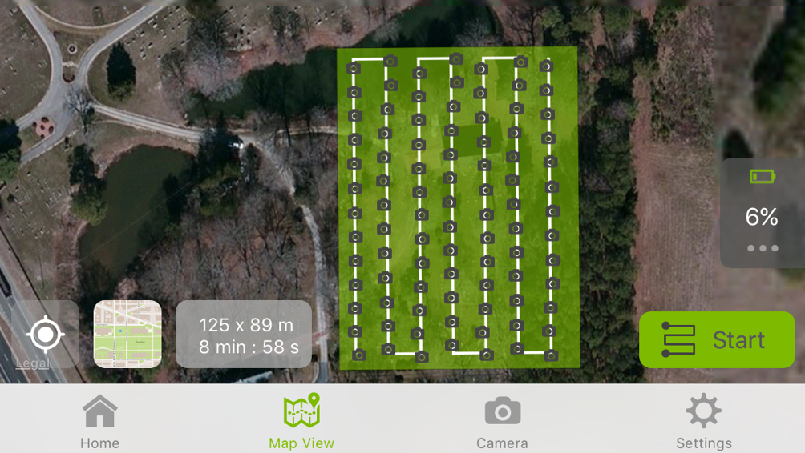
The Flight Plan

Slide 9
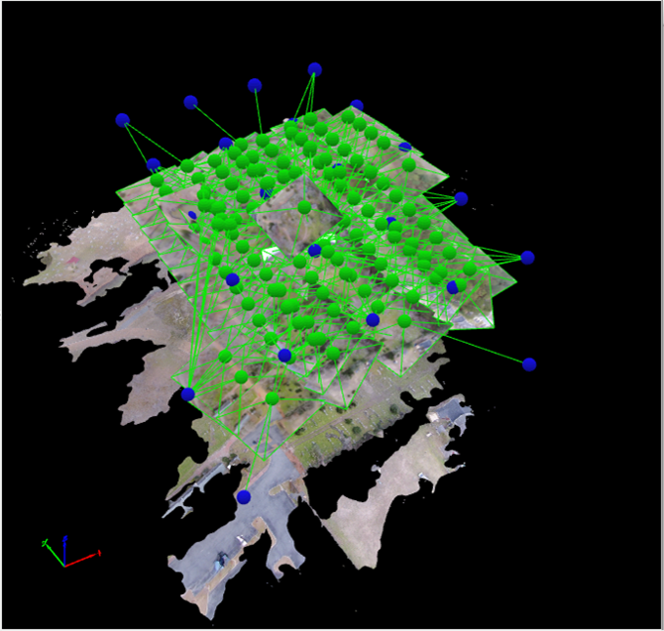
Image Processing
Generated 3D point cloud

Slide 10
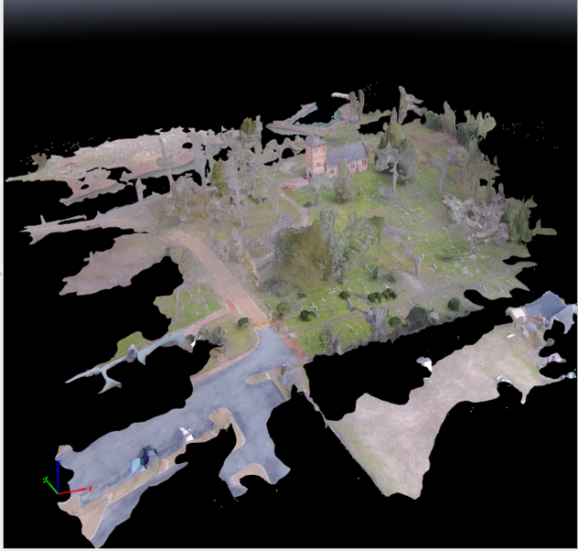
Image Processing
Collected 147 images
Generated a photo mosaic
19 hours to process
Provide St. Luke’s
Elevation models of the property
Fly-through of the property

Slide 11
Results 3D Point Cloud

Slide 12
Results
Aerial Mosaic
Elevation Model

Slide 13
Results

Slide 14
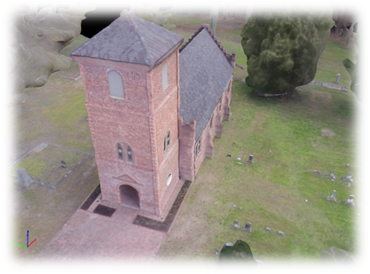
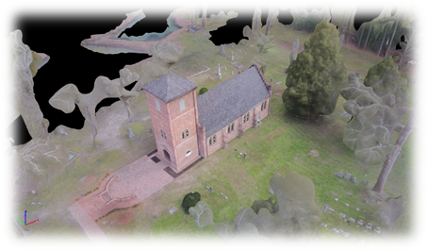
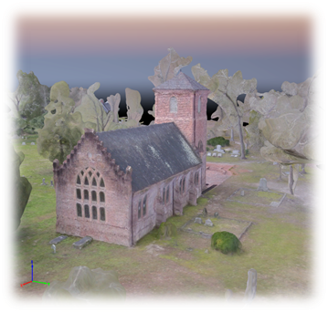
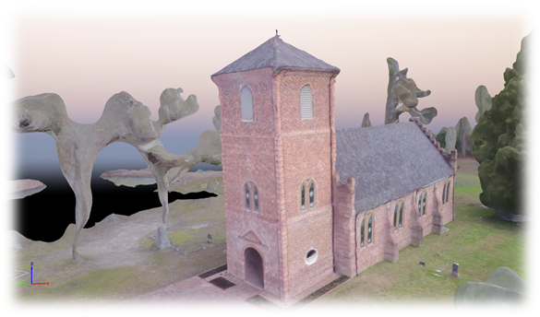
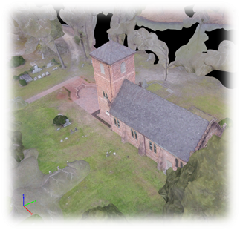
Results 3D Point Mesh

Slide 15
Challenges
Size Issue
Calibration Issues
Connection Issues
Limitation of Battery Life

Slide 16
Conclusion
Achieved the objectives
To produce aerial imagery from structural and elevation models
To make the data available for the churches uses
Created photo mosaic and 3D structural and elevation models
The data sets we have created can be easily added to Geographic Information Systems (GIS)
Other historic properties can benefit from this form of research by using the methodology, products, and approach laid out in this paper.

Slide 17
Acknowledgement
Mr. Edward Clay Swindell
Dr. Linda Hayden
Dr. Malcolm LeCompte
St. Luke Church

Slide 18
References
Phantom 2 Vision+ User Manual, V1.6, DJI Co., Los Angeles, CA, 2015, pp. 5-12.
Digital globe, USDA Farm Service Agency Map Data (2015).
Google Maps [Online]. Available: https://www.google.com/maps
Joyner Library, East Carolina Univ. (2010). Roanoke colonies illuminated [Online]. Available: https://digital.lib.ecu.edu/hakluyt/view.aspx?p=Island%20of%20 Roanoak&id=1390
A. Lamb. (2013-2015). The book: 1450 to the present [Online]. Available: http://eduscapes.com/bookhistory/artifact/6.htm
Pix4D Co. (2015). Pix4D: simply powerful [Online]. Available: https://pix4d.com/
S.A. Aqdus et al, “Discovering archeological cropmarks: a hyperspectral approach,” Dept. Geographical Earth Sciences, Univ. Glasgow, Glasgow, UK, Rep. G12-8QQ, 2008

Slide 19
QUESTIONS??

